Slide 1
ELF Virus Technoogy

Slide 2
What is an ELF Virus?
An ELF virus is a malicious piece of code that mainly targets ELF executables and infects them in such a way that after being infected, either these executables start behaving abnormally or carry out some things that are invisible to the user. Most of the time, it's the latter of the two characteristics (as mentioned earlier) that is prominent in infected ELF executables, the most common being the invisible propagation of the virus to fresh executables each time an infected executable is run. Now you can easily understand that if an ELF virus somehow gains root access to a system, it can cause havoc.

Slide 3
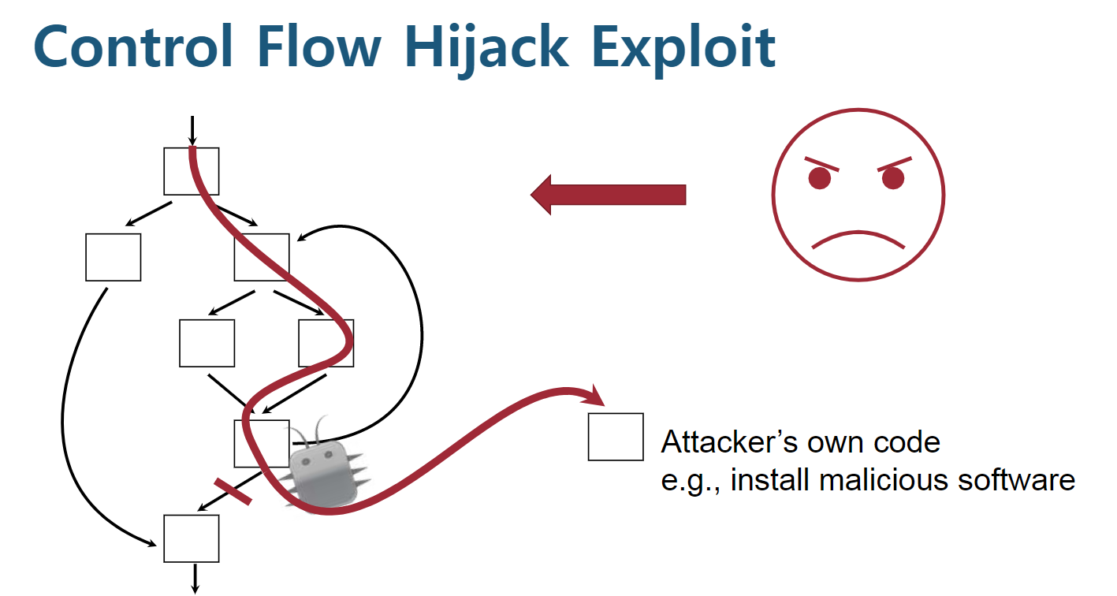

Slide 4
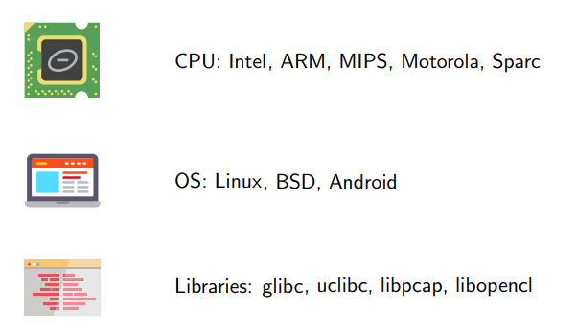
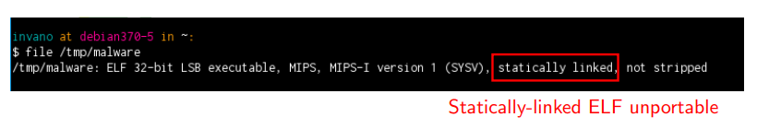
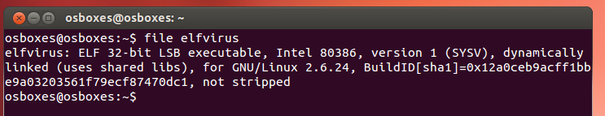
Diversity
Cozzi, Emanuele, et al. "Understanding Linux Malware." IEEE Symposium on Security & Privacy. 2018.

Slide 5
Types of ELF Viruses
Most ELF viruses are based on the Silvio Cesare File Virus.
They can be divided into two categories:
A malicious piece of code that simply prepends itself to the start of innocent executables. (sample 1)
A malicious piece of code that is injected into the text or data segment of innocent executables. (book)

Slide 6
Type 1 sample
책에 소개된 lpv.c가 작동안됨
http://www.bitlackeys.org/projects/lpv.c
그래서 다른 유사한 예제 찾아봄
https://github.com/comomind/linux_binary_analysis_study/blob/master/chap4.virus/sample1/elfvirus.c

Slide 7
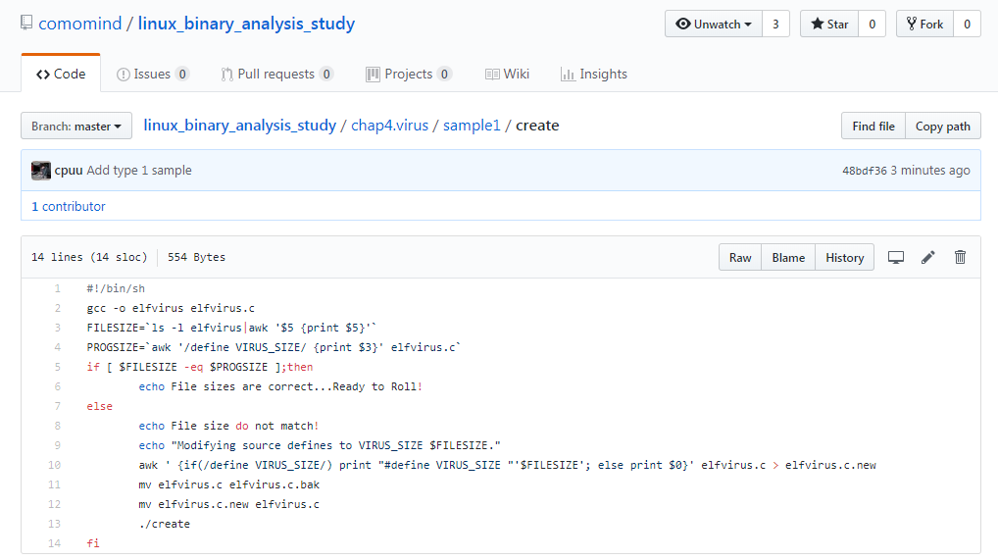
Type 1 sample
create

Slide 8
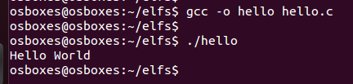
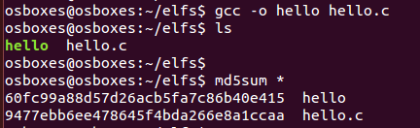
Type 1 sample
/home/osboxes/elfs/hello.c
#include <stdio.h>
int main()
{
printf("Hello World\n");
return 0;
}

Slide 9
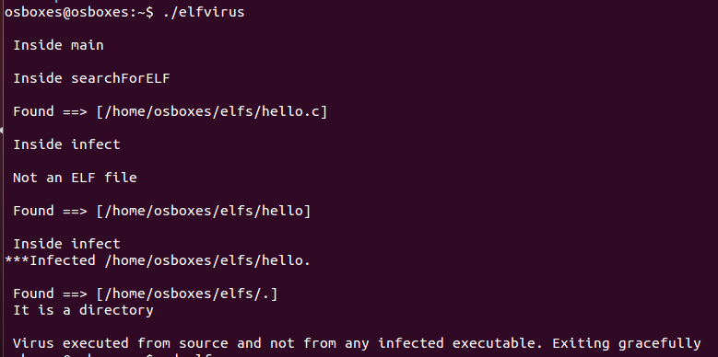
Type 1 sample
감염

Slide 10
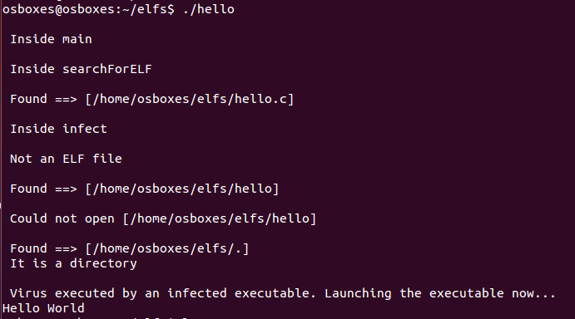

Type 1 sample
감염된 바이너리
Hash 값 달라짐 !
./hello 실행시 elfvirus의 행동이 그대로 삽입된 것을 확인. 끝난 후 기존 Hello World 수행

Slide 11
Type 1 sample Algorithm
int infect(char *filename, int fd1, char *virus) {}
ELF Header 검사
이미 감염되었는지?
Memory alloc 해서 virus code 주입
해당 메모리 내용을 Temp file로 저장
실행권한 부여
원본파일로 덮어씌움

Slide 12
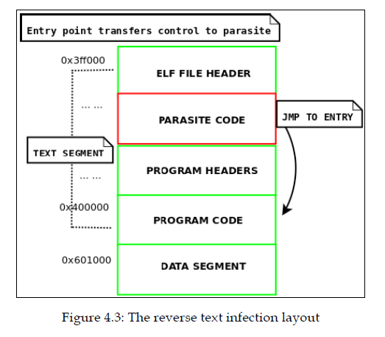
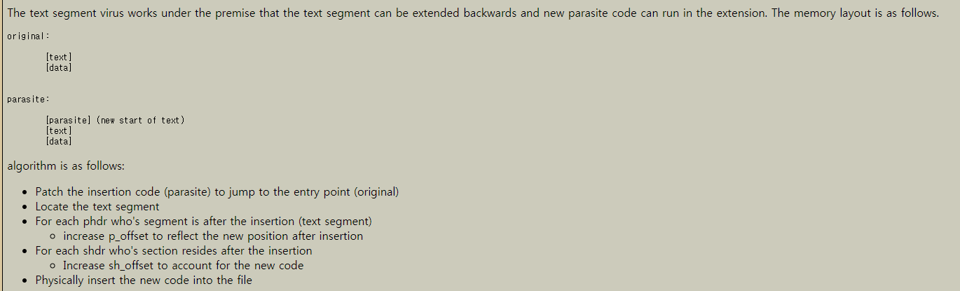
Type 2 Text segment
리버스 텍스트 세그먼트 감염방식
http://83.133.184.251/virensimulation.org/lib/vsc02.html#pc
https://www.bitlackeys.org/projects/text-infector.tgz
(파일이 존재하지 않음;;)

Slide 13
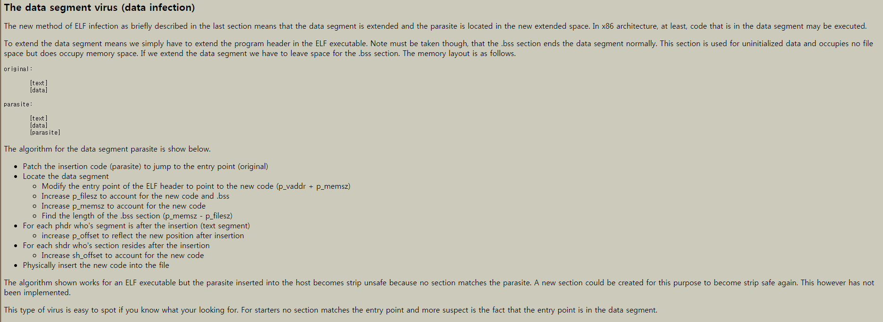
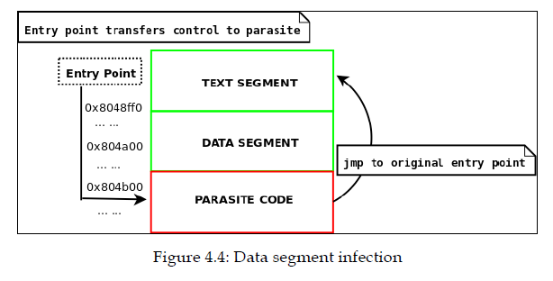
Type 3 Data segment
http://83.133.184.251/virensimulation.org/lib/vsc02.html#pa

